Slide 1

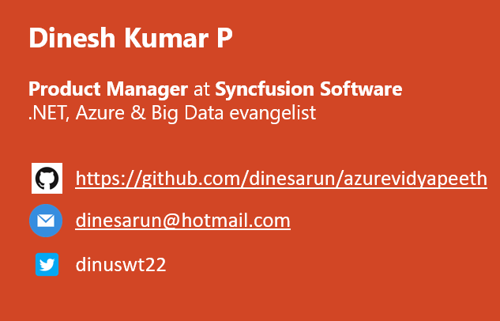
Azure Cosmos DB - End to End - Part 1
Notes:
Good afternoon guys. Ya. I am Dinesh Kumar. Product Manager at Syncfusion Software. I manage ‘Data sources’ division of Data Platform team. And I am pretty happy to present this Webinar in Azure Vidyapeeth to this wonderful audience. Here we go!

Slide 2

Agenda
Enter Text
What and Why Azure Cosmos?
Understanding Cosmos DB via Azure Portal,
Planet scale,
High availability, Replica
Consistency (What and its types)
Demos connecting Cosmos using C#,
MongoDB API - Change an app’s Data layer from MongoDB to Azure Cosmos instantly.
SQL API – A typical SQL query .NET app.
Notes:
A lot of background things happen behind the APIs we set.

Slide 3
SQL
Vertically Scalable.
Increase the load on a single server by increasing things like CPU, RAM or SSD
Adding more floors to the same building
NoSQL
Horizontally Scalable.
Can handle more traffic by sharding, or adding more servers.
Adding more buildings to the neighborhood

Slide 4
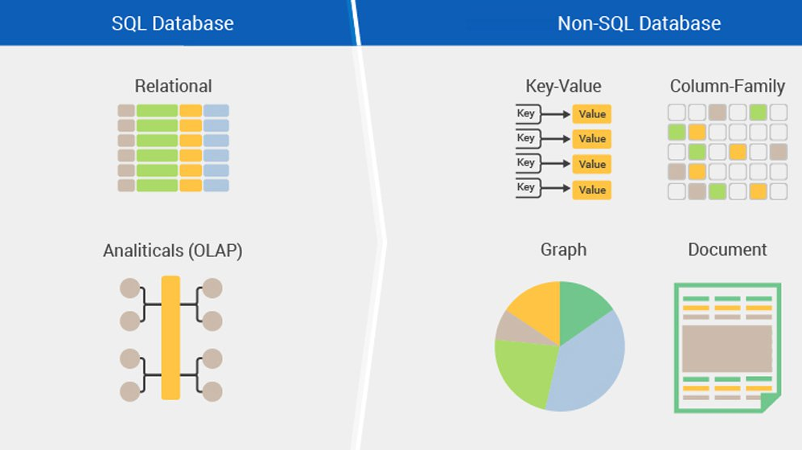
Image from: https://www.netsolutions.com/insights/5-things-you-must-consider-adopt-nosql-databases-mongodb/
Notes:
MongoDB + Cosmos DB demo will be based on Document oriented database.

Slide 5

Azure Cosmos DB
The word “Cosmos” means a well-ordered universe,
Simply mean,
No SQL
Planet Scale
JSON database
Multi – API
Improvised version of DocumentDB

Slide 6
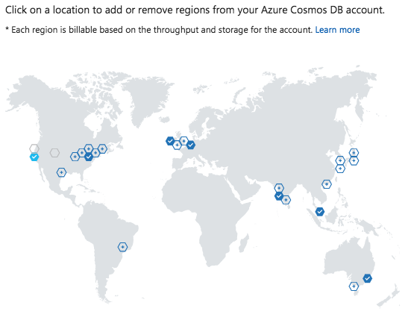
Planet Scale – What problem this solves?
Reduces Latency.
Brings fresh/live data to customers planet wise.
Write database(s) and Read database(s).

Slide 7
Consistency?
App will be used at same time by different customers all over the world. But data they get might be different.
Because Synchronization would take some time to replicate the latest change to all replicas.

Slide 8

Uses cases & Consistency
Different use cases exist where consistency should be addressed at different levels,
Definite and Immediate – Stock market, Banking (Transaction oriented)
Some what immediate – E-commerce websites (Amazon.com)
Not immediate – Social media (Facebook, Twitter)

Slide 9
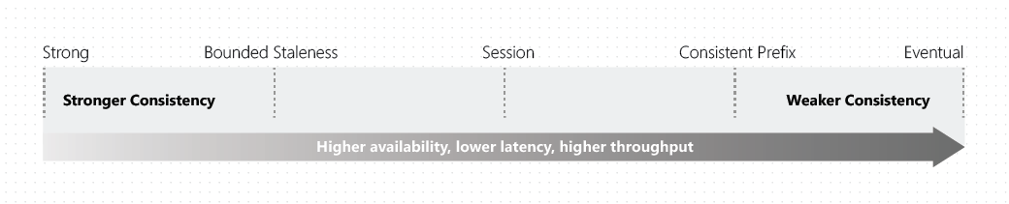
Consistency types
To address this Azure Cosmos DB has different consistency options from Strong to Eventual. Why different options is to decide based on below factors and use case need,
Performance
Consistency
Notes:
https://blog.jeremylikness.com/cloud-nosql-azure-cosmosdb-consistency-levels-cfe8348686e6
https://docs.microsoft.com/en-us/azure/cosmos-db/consistency-levels

Slide 10
Strong consistency
Consistency will be high.
Latency will exist.
Users are always guaranteed to read the latest committed write.

Slide 11
Bounded Staneless consistency
If set to 0, then it becomes a Strong consistency
Configured in two ways:
The number of versions (K) of the item
The time interval (t) by which the reads might lag behind the writes

Slide 12
Session consistency
Client who commits the data – would see fresh data.
Others would see after replica are done.

Slide 13
Prefix consistency
In all regions, data will be read in same order.
E.g. Cricket score, Election results we see different levels of data in Television, Websites like espncricinfo, other sites like news channels etc.

Slide 14
Eventual consistency
Consistency will not be there.
There's no ordering guarantee for reads
Data retrieval will be fast as Latency will be low.

Slide 15
Multi-API support
SQL
MongoDB
Graph
Table
Cassandra

Slide 16
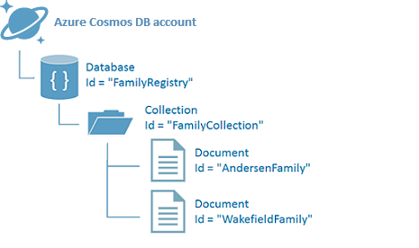
Demo

Slide 17
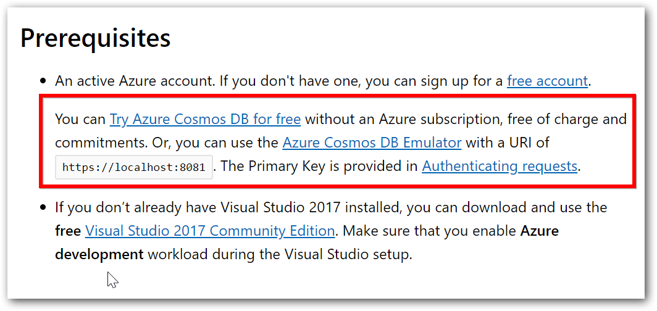
How can I try?
https://docs.microsoft.com/en-us/azure/cosmos-db/sql-api-get-started

Slide 18
Upcoming webinars
Part 2 webinar - Playing BigData analytics jobs with Apache Spark from Azure Cosmos DB.
Part 3 webinar – Data access from Azure Cosmos DB via Apache Cassandra (Column Family), Key-Value, Graph.

Slide 19
References
Enter Text
SQL demo sample - https://docs.microsoft.com/en-us/azure/cosmos-db/sql-api-get-started
Learning path - https://docs.microsoft.com/en-us/learn/paths/work-with-nosql-data-in-azure-cosmos-db/
Azure Cosmos DB's API for MongoDB - https://docs.microsoft.com/en-us/azure/cosmos-db/mongodb-introduction

Slide 20



Enter Text
Questions ?
https://github.com/dinesarun/azurevidyapeeth
dinesarun@hotmail.com
dinuswt22

